Slide 1
8-bit ALU Implementation
with Verilog HDL
허 규, 고혁준, 김도현

Slide 2
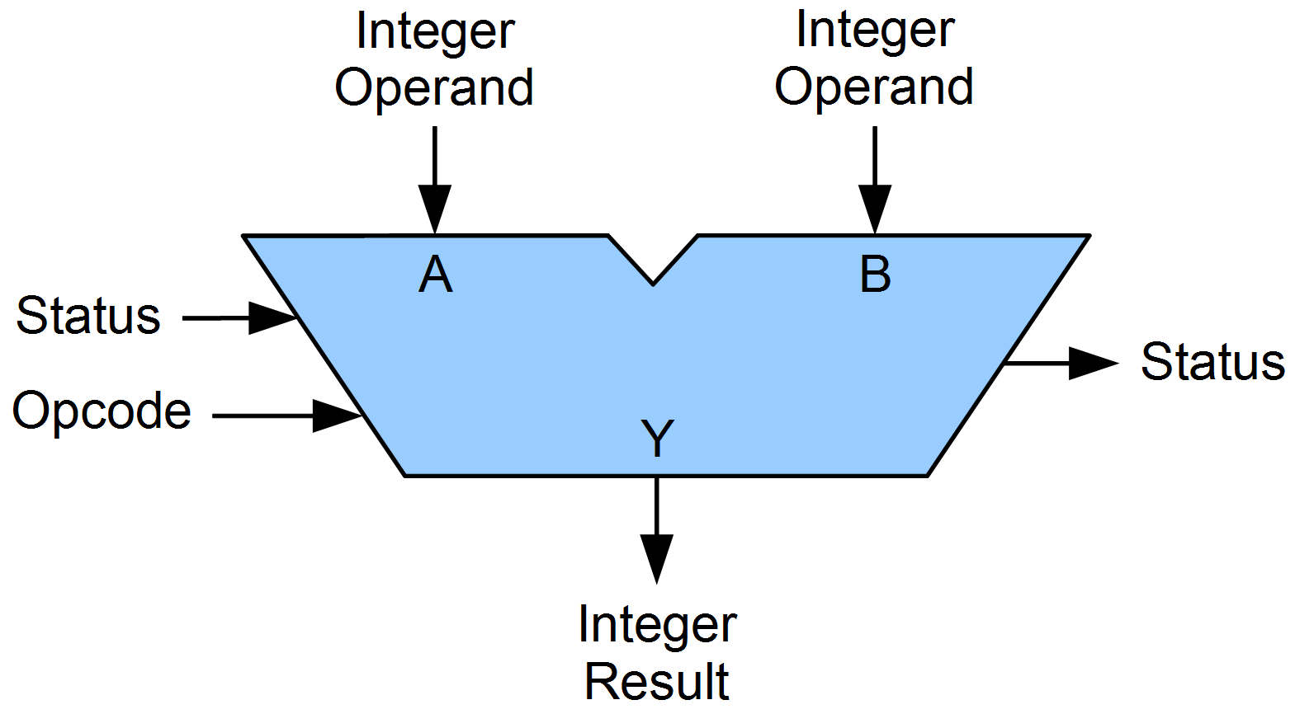
ALU
Performs arithmetic and bitwise operations
Symbolic representations of ALU.

Slide 3
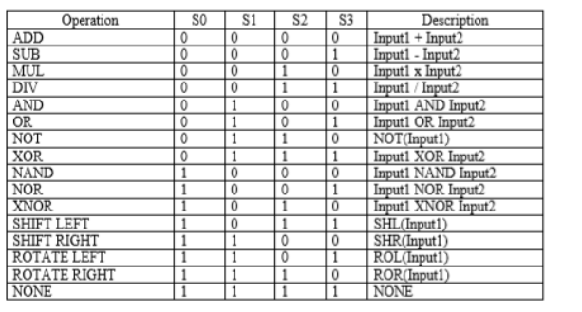
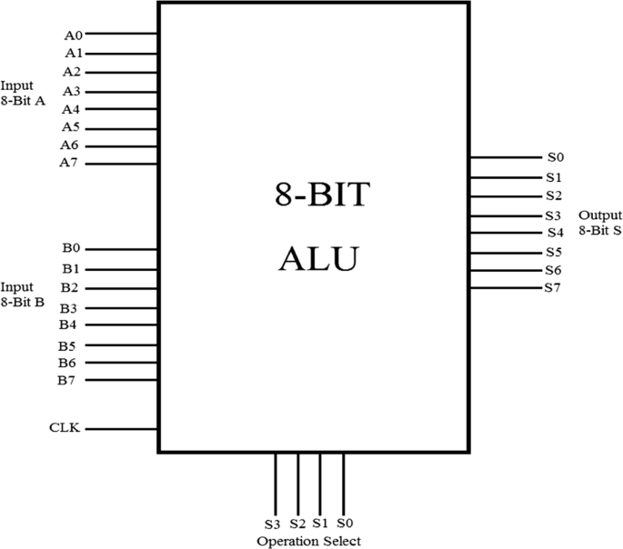
8 bit ALU

Slide 4
Additior

Slide 5
Addition
How to implement 8 bit addition : Full Adder
Idea
1bit full adder(fulladder) -> 4bit fulladder(fulladder4)
-> 8bit fulladder(fulladder8)

Slide 6
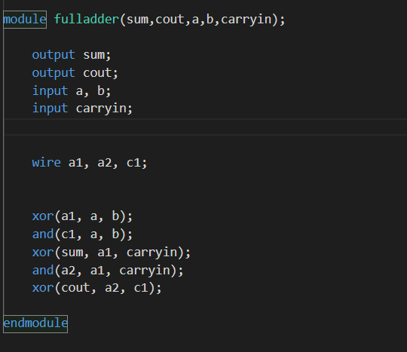
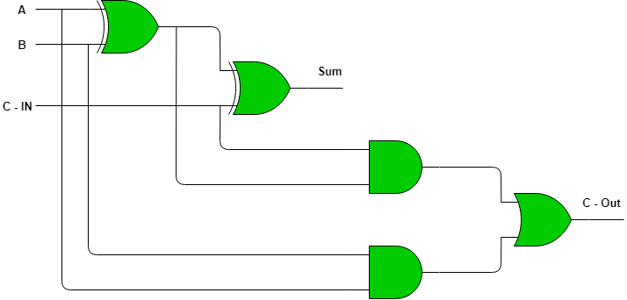
Fulladder > Fulladder4 > Fulladder8

Slide 7
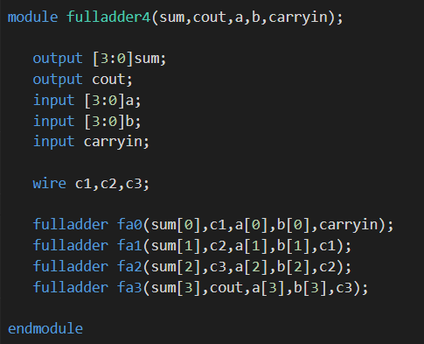
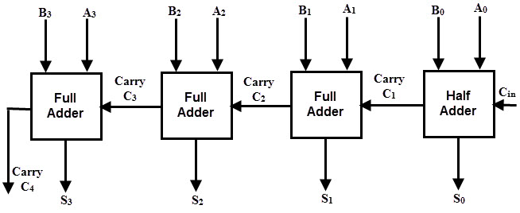
Fulladder > Fulladder4 > Fulladder8

Slide 8
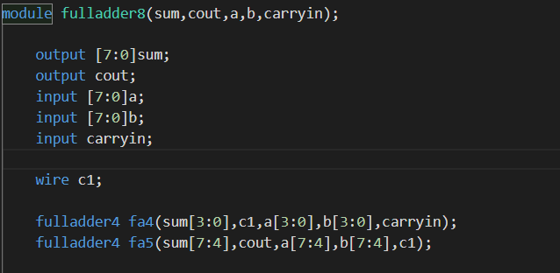
Fulladder > Fulladder4 > Fulladder8
4bit
fulladder
4bit
fulladder

Slide 9
Subtractor

Slide 10
Subtraction - Idea
A – B = A + (-B)

Slide 11
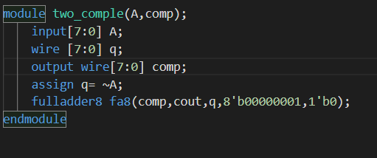
Two_comple > Subtract8
A
q=~A
1
cout
8bit
fulladder
1
output

Slide 12
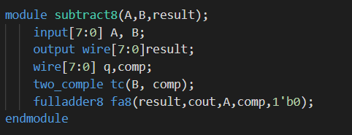
Two_comple > Subtract8
-B
A
cout
8bit
fulladder
1
output

Slide 13
Multiplicator

Slide 14
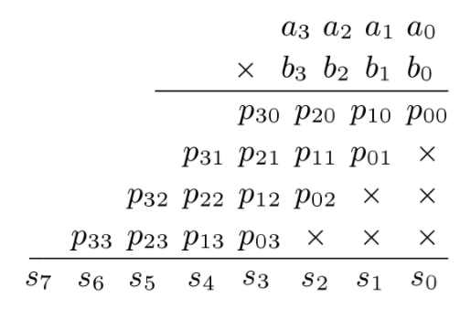
Multiplicator

Slide 15
Multiplicator
Start
multiplication
multiplicand
Multiplier0=1
Multiplier0=0
Test multiplier0
Add multiplicand to the left half of the product and place the result in the left half of the product register
Product
Shift the product register right 1 bit
8nd repetition
Done

Slide 16
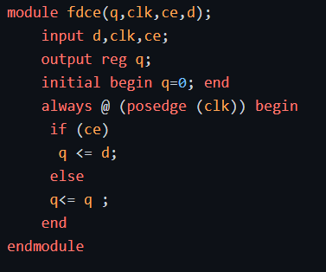
Multiplicator
D | Q(t+1) | Q’(t+1)
0 | 0 | 1
1 | 1 | 0

Slide 17
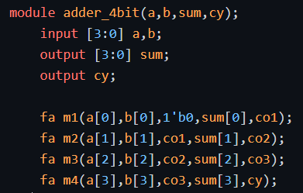
Multiplicator

Slide 18
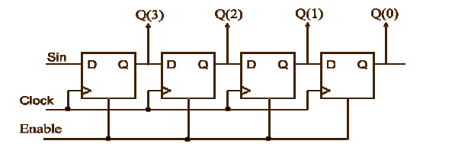
Multiplicator

Slide 19
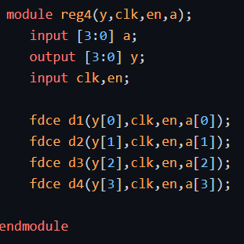
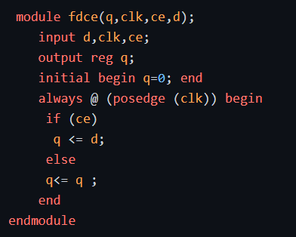
Multiplicator

Slide 20
Shift & Divider

Slide 21
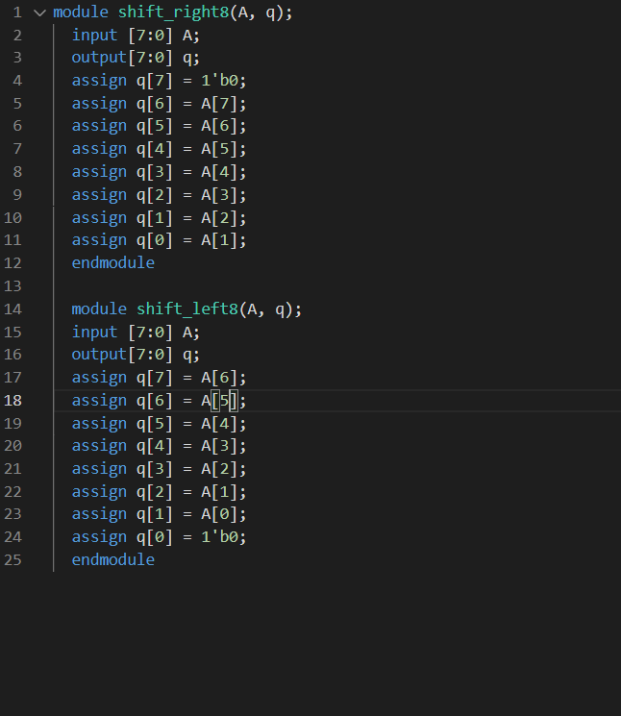
Shift Module
A
Q
0

Slide 22
How to implement Divider?
In Example A = 0111, B = 0010, 4-bit environment
R
S
Q
0000
1110
0000
0001
1100
0000
0011
1000
0000
0001
1000
0001
(R = R – B)
(Q = Q +1)
0011
0000
0010
0001
0000
0011

Slide 23
8-bit Divider Implementation – Logic Diagram
S’0
S0
S’1
S1
7
S2
sub_out
S3
2×1
MUX
.
0
8- bit
Subtractor
A
Lshift
a0
0
R2
Lshift
a1
7
add_out
Lshift
a2
9 × 1
MUX
1
Lshift
a3
0
8- bit
Adder
cin
cout
.
0
.
R1
.
S’’0
.
S’’1
7
7
a6
Lshift
a7
.
B
2×1
MUX
0
0
0
R3
Q

Slide 24
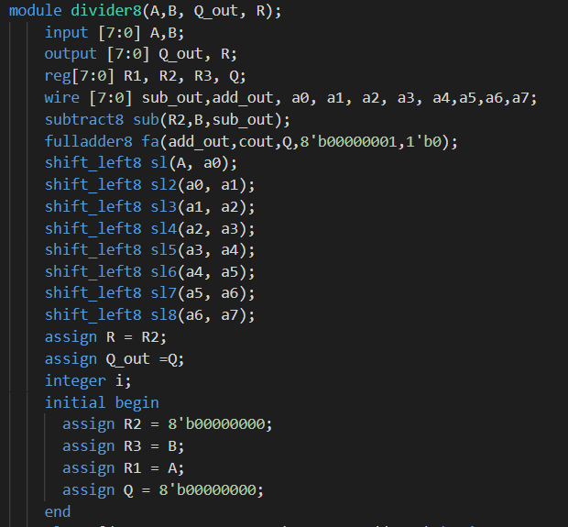
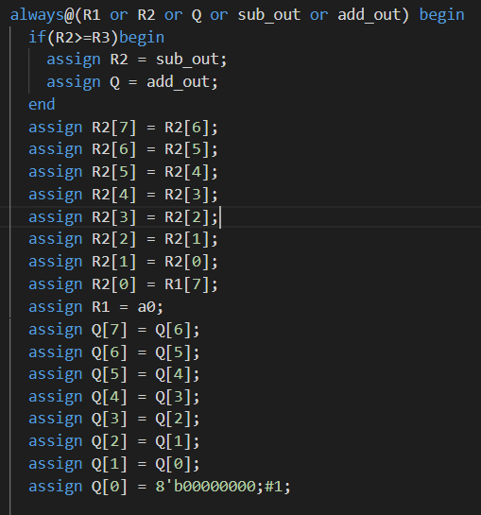
Divider – Code implementation

Slide 25
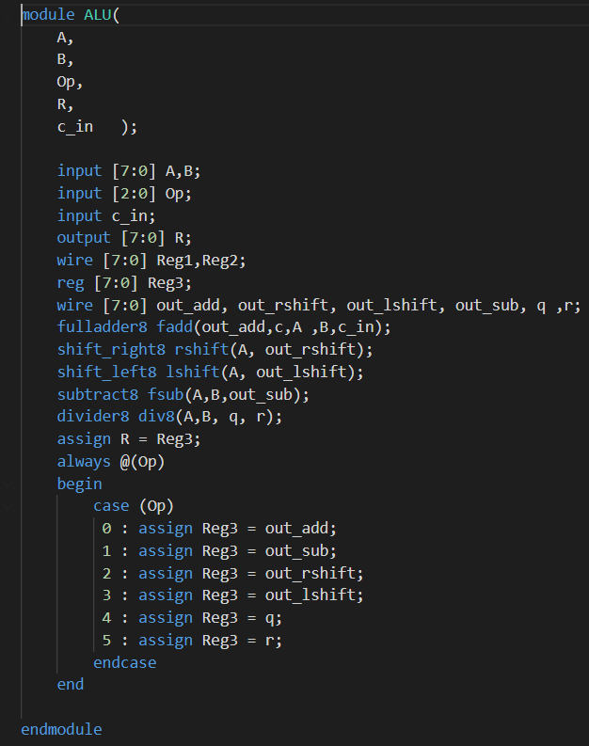
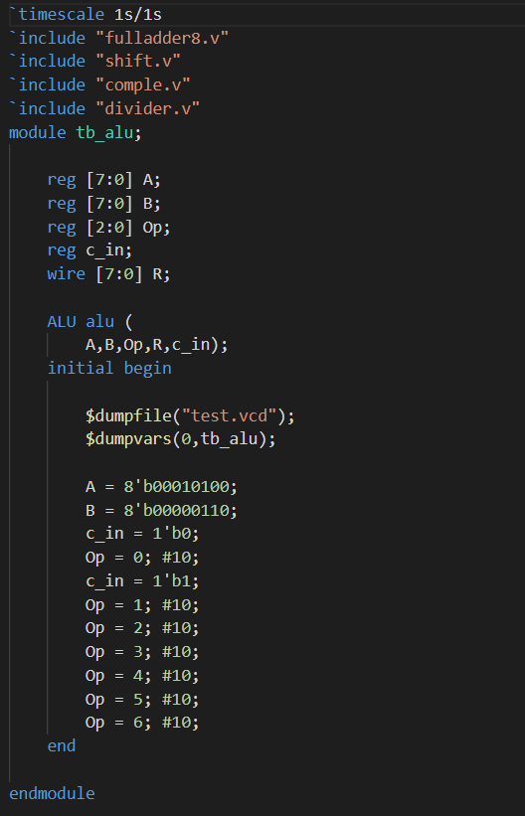
ALU – Code implementation

Slide 26
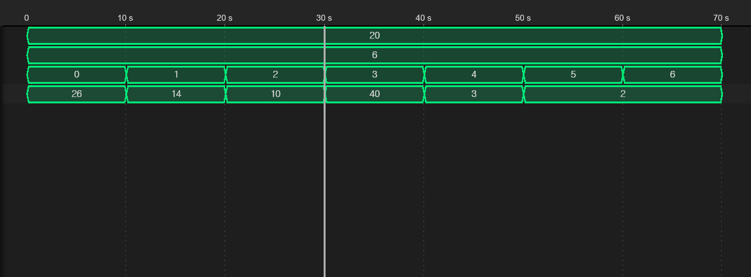
Final Output
Add
Sub
RShift
LShift
Quot
Remain

